Slide 1


Attendance QR (Week 7, Session 2)

Slide 2
Meeting 7
STM32 SPI Communication
IEEE - CSULB Branch

Slide 3
Agenda
Communication Protocol Review
Features of Serial Peripheral Interface (SPI)
SPI Lines
Demo: PCB Layout Creation

Slide 4
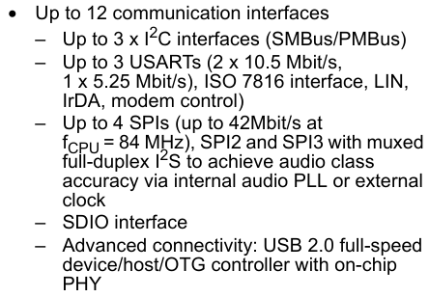
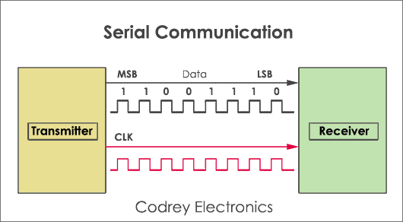
Communication Protocol Review
Communication Protocols are a set of rules and formats enabling the transmission of data between devices.
Master (MCU) and slave (sensor) configuration.
MOSI/MISO (or CIPO/COPI) pins
Both agree on a common communication protocol or “language”
Common serial communication (one bit at a time) include:
UART/USART, I2C, USB, SPI
Each varies based on wire count, (a)synchronous, speed, data flow direction (simplex, half-duplex, duplex), etc.
Notes:
Talk about what makes the MCU a master (clock, communication steps)
COPI - Controller out, peripheral in

Slide 5
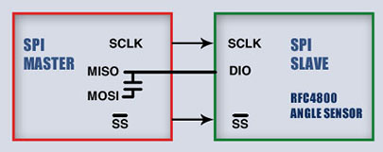
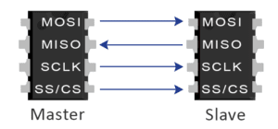
Features of Serial Peripheral Interface (SPI)
Key Features:
3-Wire (Half-duplex) or 4-Wire (Duplex) or more
Synchronous (Bits sent/received at the MCU clock speed)
Faster bit rate compared to older I2C and UART
Loosely defined in terms of frame formats, # of bits transmitted, voltage levels, etc.
Often used for data transfer between one controller and one or more peripherals
3-Wire
4-Wire

Slide 6
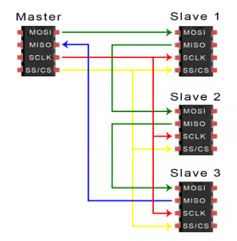
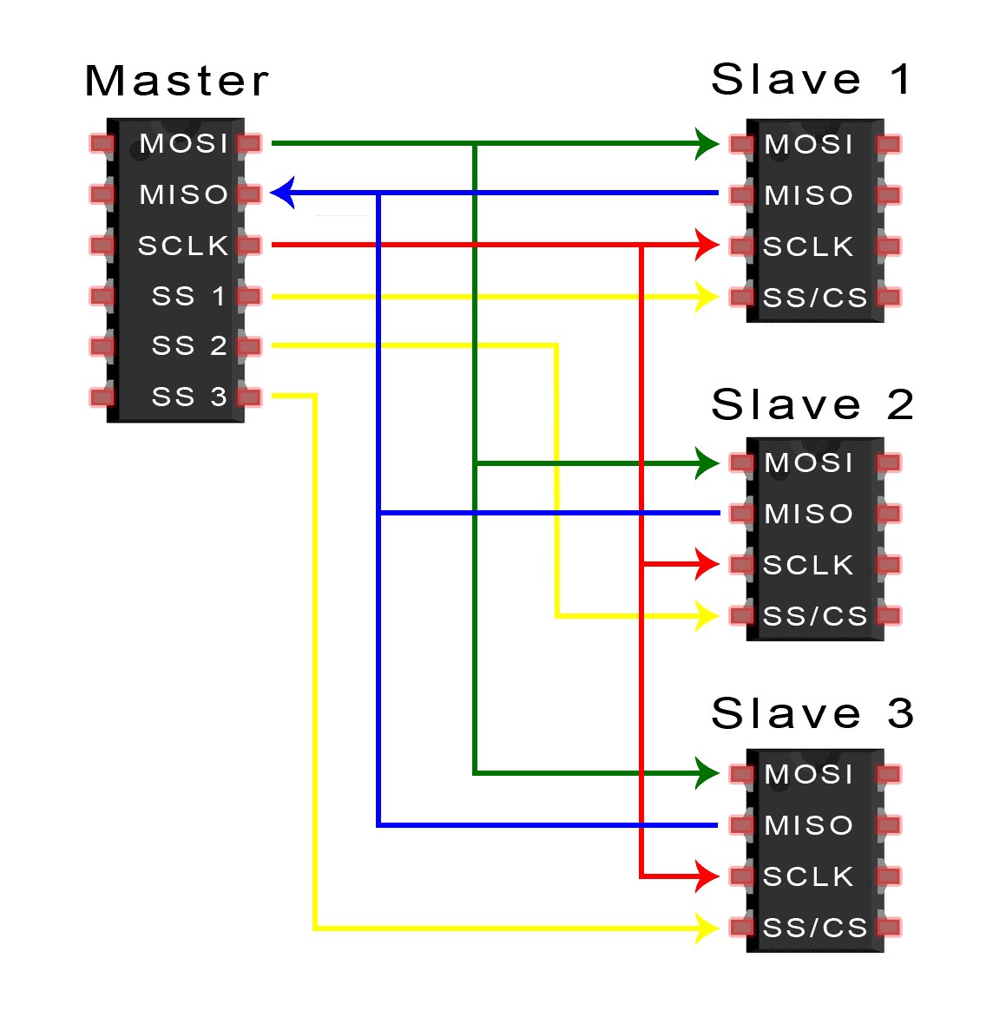
SPI Lines (CS)
SS (Slave Select) or CS (Chip Select) line determines what “chip” the MCU communicates with.
With multiple CS lines connected to their own peripherals:
Individual CS line pulled low activates that device (“active low”).
With one CS line, MISO/MOSI lines are daisy chained across devices with data sent through each and back to MCU.

Slide 7
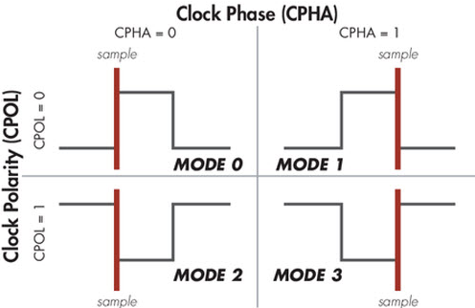
SPI Lines (SCLK)
SCLK is the clock line whose frequency can be chosen by the MCU.
One bit read per clock signal.
Clock can be idle low or idle high called clock polarity (CPOL).
Data can be sampled at leading (first) or trailing (second) edge called clock phase (CPHA).
4 possible SPI modes.
All interconnected SPI devices must use same mode.
Notes:
0 Mode is the most common

Slide 8
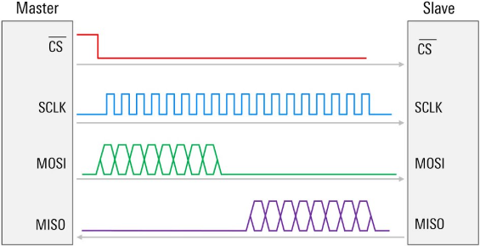
SPI Lines (MOSI/MISO)
MOSI line is used to send data from the master to the slave.
MISO line is used to send data from the slave to the master.
Some devices only receive data from master.
MISO sent as response to data on MOSI line.

Slide 9
Demo: PCB Layout Creation
What is needed?
Software:
Altium Designer
Links:
JCLPCB Constraints
JCLPCB Order

Slide 10
Join us next meeting for the Final Project!
Nothing new is needed for next week. Any Questions?

